Slide 1
Lecture 9 Tree
Abrar Hasan
Lecturer
Dept. of Software Engineering
Daffodil International University

Slide 2
Table of contents
01
02
03
<
T
0
>
Tree Traversal Technique
Introduction to Tree
Terminologies

Slide 3
01
Tree
<
T
1
>
Brief Description about Tree

Slide 4
Tree
<
T
1
>
There would be some leaf
One root
And some nodes

Slide 5
Tree
<
T
1
>
A tree is a non empty finite set of one or more nodes such that:
There is a specially designated node called the root.
The remaining nodes are partitioned into n>=0 disjoint sets T1, ..., Tn, where each of these sets can be a tree.

Slide 6
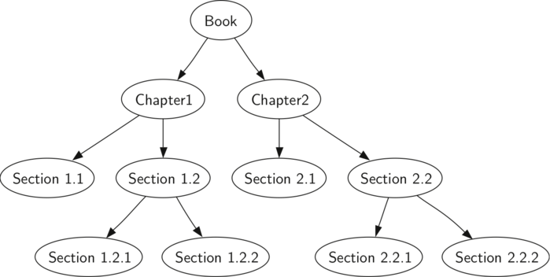
Tree
<
T
1
>

Slide 7
<
T
1
>
Tree data structure
Left
Value
Right
Left
Value
Right
Left
Value
Right
Left
Value
Right
Left
Value
Right
null
Value
null
null
Value
null
null
Value
null
null
Value
null

Slide 8
02
Terminology
<
T
2
>

Slide 9
Terminology
<
T
2
>
Root: If the tree is not empty, the first node is called the root
ROOT

Slide 10
Terminology
<
T
2
>
In=0
Out= 2
Degree: Connection with nodes by edges
Indegree: Total no of incoming edges
Outdegree: Total no of outgoing edges
In=1
Out= 2
In=1
Out= 2
In=1
Out= 0
In=1
Out= 0
In=1
Out= 0
In=1
Out= 0

Slide 11
Terminology
<
T
2
>
In=0
Out= 2
Parent Node: A node is a parent if it has successor nodes—that is, if it has an outdegree greater than zero.
Child Node: a node with a predecessor is a child. A child node has an indegree of one.
In=1
Out= 2
In=1
Out= 2
Parent
In=1
Out= 0
In=1
Out= 0
In=1
Out= 0
In=1
Out= 0

Slide 12
Terminology
<
T
2
>
Leaf Node: A leaf is any node with an outdegree of zero, that is, a node with no successors.
Sibling: Two or more nodes with the same parent are siblings

Slide 13
Terminology
<
T
2
>
Path: A path is a sequence of nodes in which each node is adjacent to the next one.
Level: The level of a node is its distance from the root. Because the root has a zero distance from itself, the root is at level 0.
Height :The height of the tree is the level (starts from 0) of the leaf in the longest path from the root plus 1
Depth: (Similar as Height, just node to root)
Size : Total Number of Elements/Nodes

Slide 14
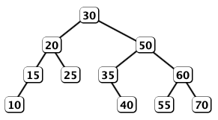
Binary Tree
<
T
2
>
Binary tree is a tree data structure in which each node has at most two children, which are referred to as the left child and the right child.

Slide 15
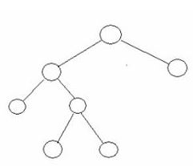
Full Tree
<
T
2
>
A binary tree in which each node has exactly zero or two children is called a full binary tree. In a full tree, there are no nodes with exactly one child.

Slide 16
Complete Tree
<
T
2
>
A Complete Binary Tree is a tree, which is completely filled, with the possible exception of the bottom level, which is filled from left to right. A complete binary tree of the height h has between 2^{h} and 2^{(h+1)}-1 nodes. Here are some examples, where h=3:

Slide 17
03
Tree Traversal
<
T
3
>

Slide 18
Tree Traverse
<
T
3
>
Pre Order Tree (Root, Left Child, Right Child)
In Order Tree (Left Child, Root, Right Child)
Post Order Tree (Left Child, Right Child , Root)

Slide 19
Pre Order
<
T
3
>
A
(Root, Left Child, Right Child)
B
C
D
E
H
G
H
I
J
Pre Order: A,B,D,E,H,C,F,I,G,J

Slide 20
In Order
<
T
3
>
A
(Left Child, Root, Right Child)
B
C
D
E
H
G
H
I
J
In Order: D,B,E,H,A,I,F,C,J,G

Slide 21
Post Order
<
T
3
>
A
(Left Child, Right Child , Root)
B
C
D
E
F
G
H
I
J
Post Order: D,H,E,B,I,F,J,G,C,A

Slide 22
<
T
3
>
Any Question?

Slide 23
Thank You
<
T
3
>

